Slide 1
ASP.NET
Securing APIs

Slide 2
Securing APIs
1
Introduction

Slide 3
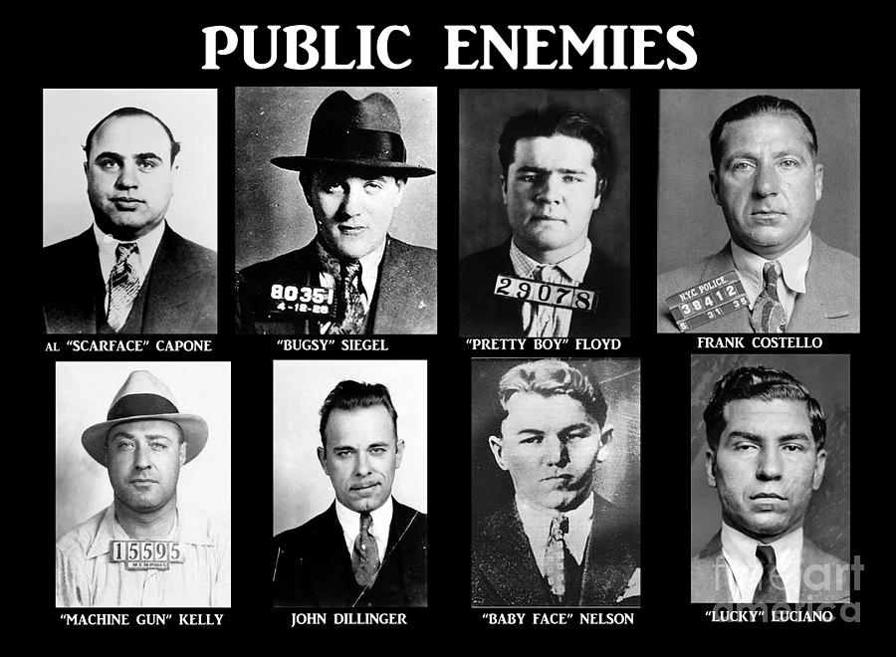

Slide 4
Introduction
Not limited to authentication and authorization
But also protecting the underlying structure (dos, ddos)
ASP.NET Core offers a wide range of features to help

Slide 5
Securing APIs
1
Authentication and authorization

Slide 6


Slide 7
Authentication and authorization
Authentication
Process of verifying the identity
Authorization
Has the authenticated user sufficient rights to do things

Slide 8
Typical authentication flow
Client
HTTP Server
Anonymous
401: Unauthorized
WWW-authenticate: Basic
Authorization: Basic xxxxxx
200 OK

Slide 9
The players
Anonymous
Not an authentication scheme,
No authentication information
Used to grant access to everyone
Basic authentication
Oldest scheme for authenticating users
String with username and password
Encoded as a base64 string

Slide 10
The players
Digest
Replacement scheme for the basic authentication scheme
Server sends a random string to the client: challenge
The client authenticates them by sending a hash that contains a username, password and the challenge
Bearer
Most popular and secure authentication schemes
Makes use of bearer tokens for accessing Oauth 2.0

Slide 11
Securing APIs
3
Bearer authentication scheme

Slide 12
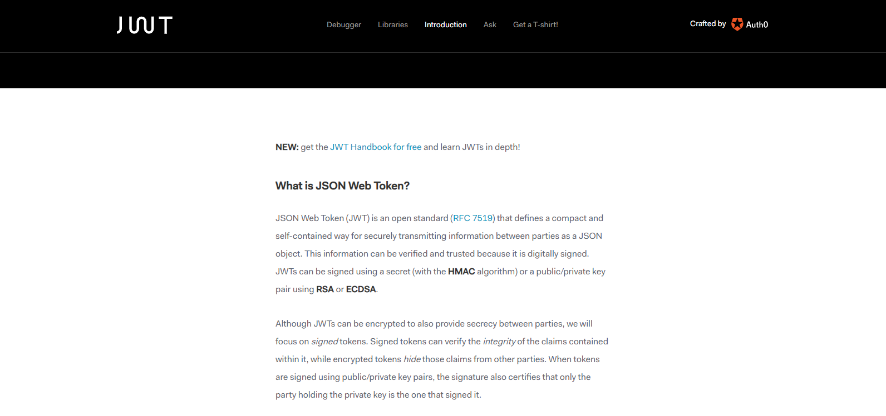
https://jwt.io/introduction/
Notes:
https://auth0.com/blog/securing-asp-dot-net-core-2-applications-with-jwts/

Slide 13
Bearer authentication scheme
We will make use of JSON Web Tokens (JWT)
Open and industry standard for representing claims
JWT provides a compact and self-contained way to transfer information between 2 parties as a JSON object
JWT consists out of 3 parts
Header
Payload
signature

Slide 14
Typical bearer authentication flow
Client
HTTP Server
POST /api/authenticate
JWT Bearer Token
Authorization: Bearer <JWT Token>
200 OK

Slide 15
Getting started
Add authentication middleware
public void ConfigureServices(IServiceCollection services)
{
services
.AddAuthentication(JwtBearerDefaults.AuthenticationScheme)
.AddJwtBearer(options =>
{
var serverSecret = new
SymmetricSecurityKey(Encoding.UTF8.GetBytes(Configuration["JWT:ServerSecret"]));
options.TokenValidationParameters = new TokenValidationParameters
{
IssuerSigningKey = serverSecret,
ValidIssuer = Configuration["JWT:Issuer"],
ValidAudience = Configuration["JWT:Audience"]
};
});
services.AddMvc().SetCompatibilityVersion(CompatibilityVersion.Latest);
}
Notes:
https://auth0.com/blog/securing-asp-dot-net-core-2-applications-with-jwts/

Slide 16
Getting Started
[Route("api/[controller]")]
[ApiController]
[Authorize]
public class ValuesController : ControllerBase
{

Slide 17
